Slide 1
General Introduction

Slide 2
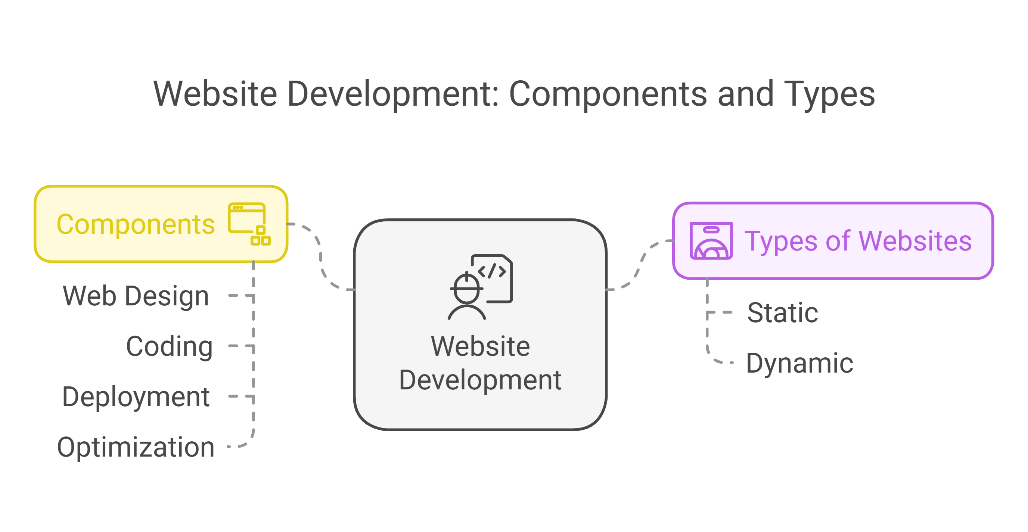
What is Website Development?
Definition:
The process of creating and maintaining websites.
Encompasses web design, coding, deployment, and optimization.
Types of Websites:
Static: Fixed content, no user interaction(e.g., a simple resume website).
Dynamic: Interactive, data-driven(e.g., Facebook, Twitter).

Slide 3
Static vs Dynamic Websites
Static Websites: Fixed content (HTML & CSS only), no user interaction. Example: Personal blogs, documentation pages.
Dynamic Websites: Content changes based on user input. Example: Facebook, Amazon.
Which one to choose?
Static = Simplicity, Dynamic = Interactive experience.

Slide 4
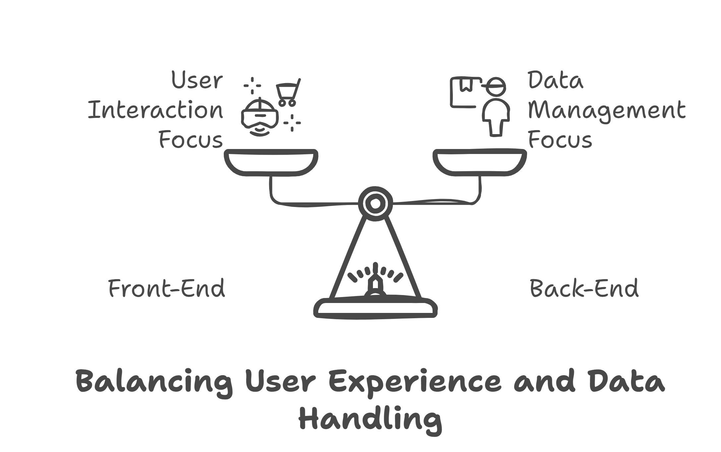
Front-End, Back-End, and Databases
Front-End:
User Interface (UI) of the website visible to users.
Technologies: HTML, CSS, JavaScript.
Example: The homepage design and buttons.
Back-End:
Server-side operations managing data and logic.
Technologies: Node.js, Python, PHP.
Example: Fetching and storing user login details.

Slide 5
Databases:
Storage for website data.
Types: Relational (MySQL) and NoSQL (MongoDB).
Relational: Organize data into structured tables with rows and columns.
Non Relational: Store data in flexible formats like JSON, documents, or key-value pairs.

Slide 6
How the Web Works
The web follows a Client-Server Architecture.
Client: The browser that sends requests.
Server: A machine that processes requests and sends responses.
HTTP Request Lifecycle: Request → Process → Response.
Example: Typing google.com → Browser sends request → Google’s server processes → Sends back a webpage.

Slide 7
What Happens When You Type a URL in a Browser?
DNS Lookup → Resolves domain (e.g., google.com) to an IP address.
Browser Sends HTTP Request → Asks the server for webpage content.
Server Processes the Request → Fetches necessary files (HTML, CSS, JS).
Response is Sent Back → Browser renders the page.

Slide 8
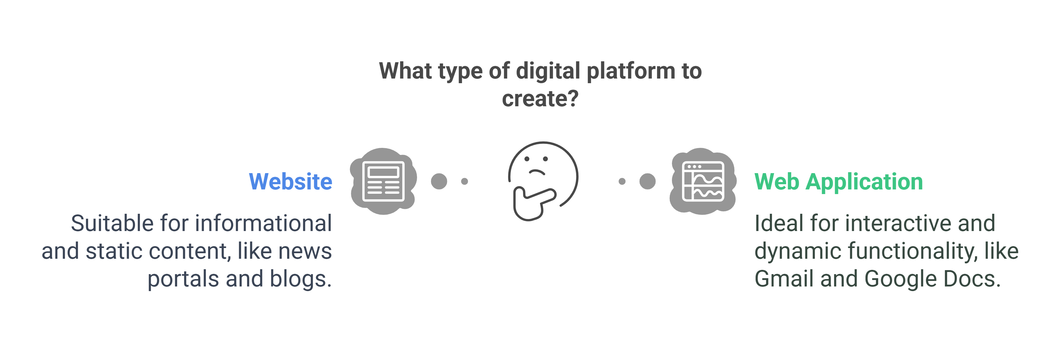
Website vs Web Application
Website:
Informational, mostly static or semi-dynamic.
Example: News portals, blogs.
Web Application:
Interactive, dynamic, and functionality-driven.
Example: Gmail, Google Docs.

Slide 9
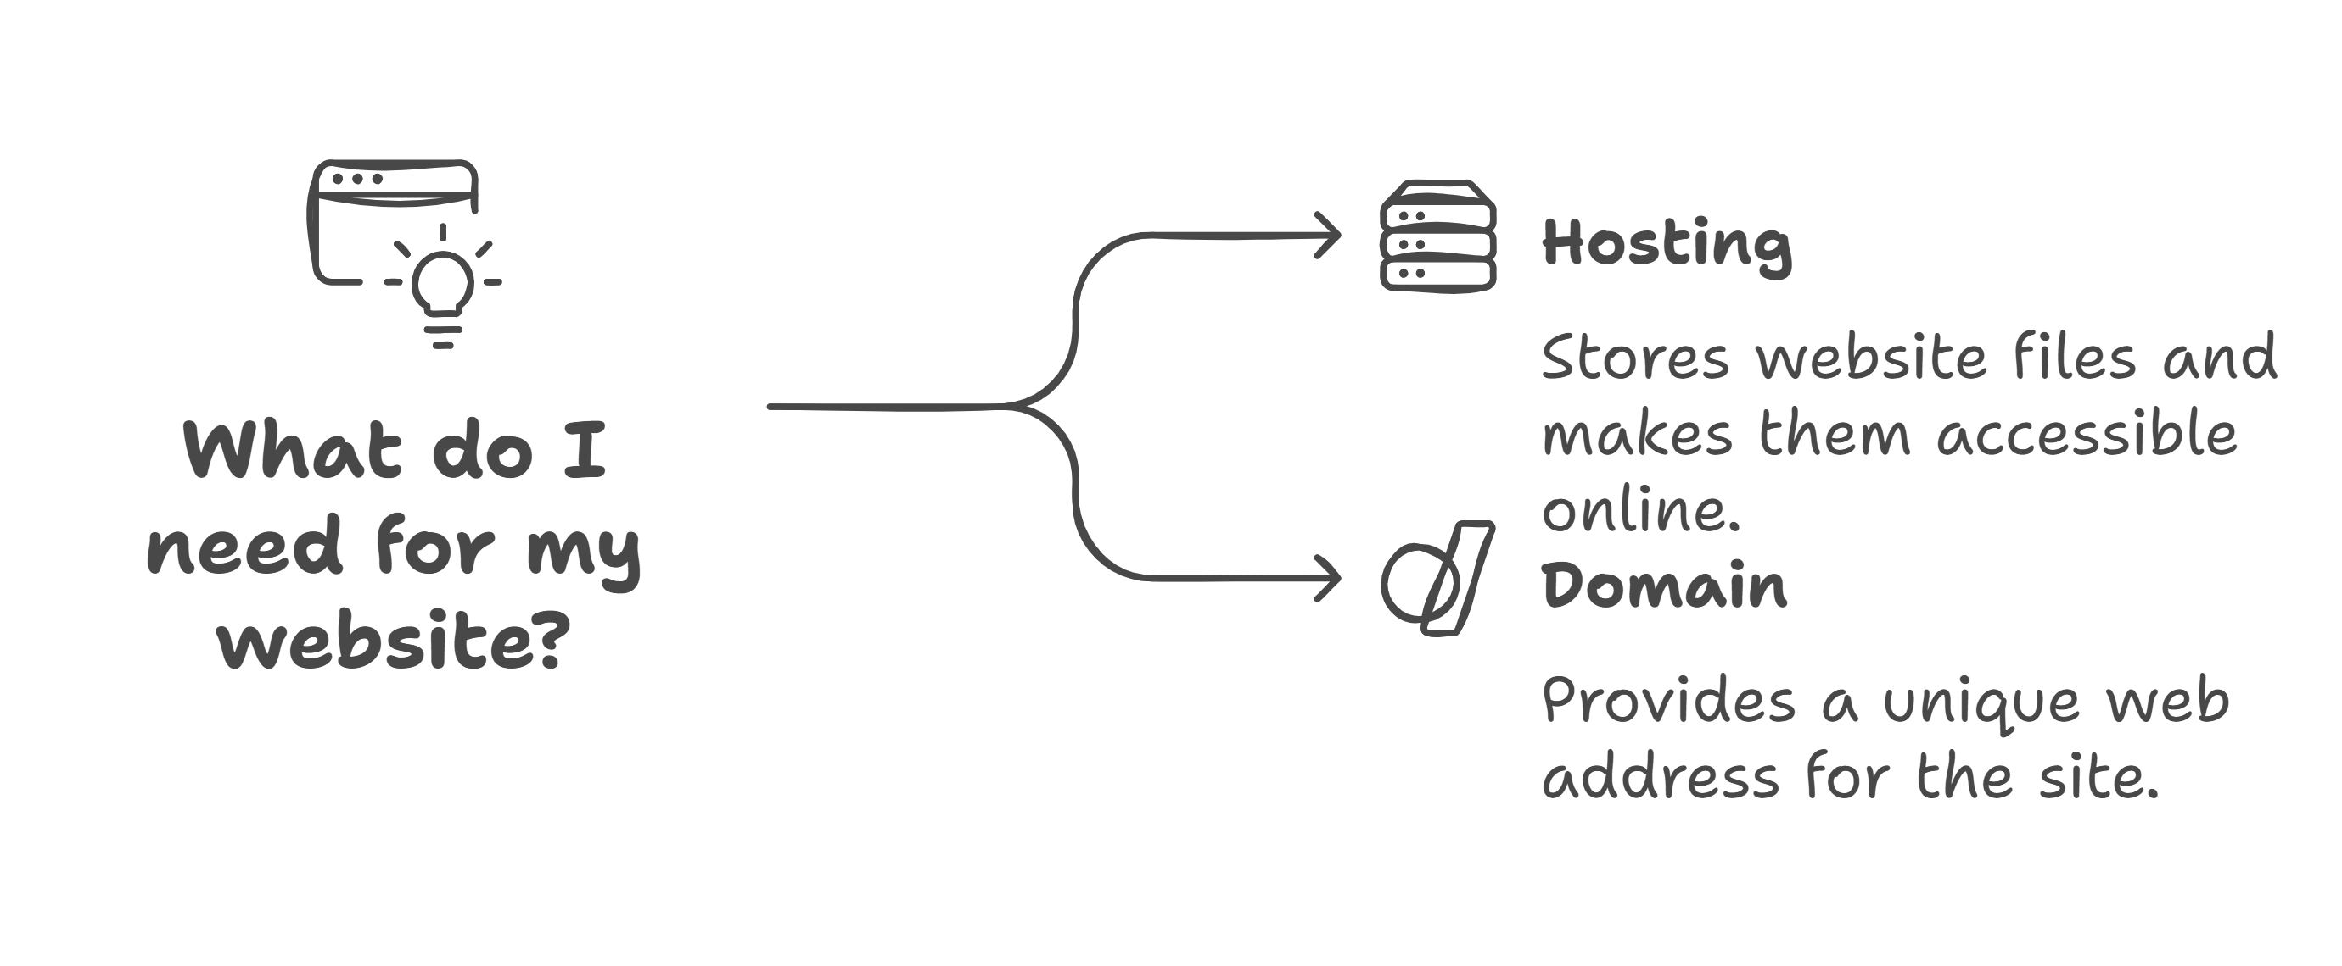
Hosting vs Domain
Hosting:
A service that stores website files on a server, making them accessible online.
Example Providers: AWS, Bluehost, Hostinger.
Domain:
A unique address for a website (e.g., www.example.com).
Purchased from registrars like GoDaddy or Namecheap.
Practical Example:
Demonstrate accessing a website by typing its domain in a browser.

Slide 10
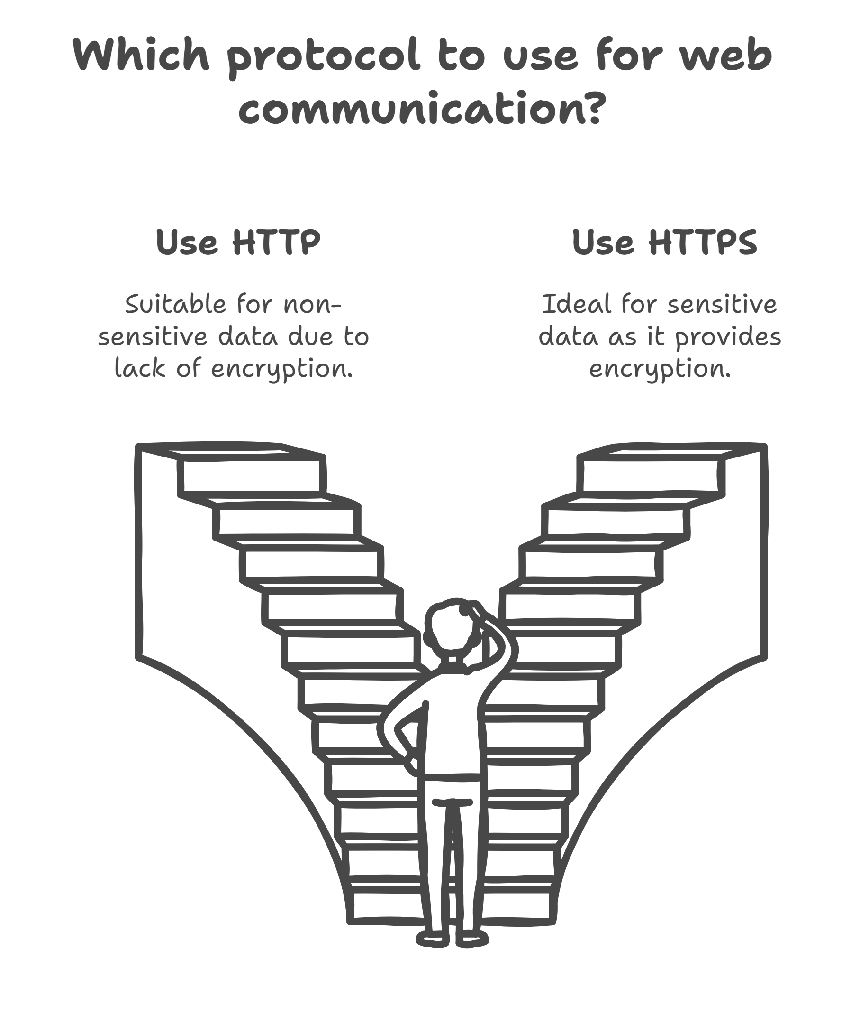
HTTP vs HTTPS
HTTP:
Hypertext Transfer Protocol.
No encryption; data is sent as plain text.
It is the foundation of data communication on the web.
HTTPS:
HTTP with Secure Socket Layer (SSL).
Encrypts data for security.
Protects sensitive information like passwords and payment details.
Websites with HTTPS show a padlock icon in the browser's address bar.

Slide 11
Version Control Systems (VCS)
What is Git?
A free, distributed version control system designed for speed and efficiency.
Used to track changes in code and manage versions.
Benefits of Version Control:
Keeps track of code history.
Allows reverting to previous versions if mistakes are made.
Facilitates teamwork with minimal conflicts.
Git vs GitHub
What is Version Control?
A system that helps track changes to files over time.
Enables collaboration without overwriting each other's work.

Slide 12
What is GitHub?
A platform for hosting Git repositories(folders) online.
Enables collaboration through features like pull requests, issue tracking, and code reviews.
Key Differences:
Feature | Git | GitHub
Definition | VCS to manage code. | Platform for hosting Git repos.
Installation | Installed locally. | Accessible via a web browser.
Purpose | Version control. | Collaboration and sharing.

Slide 13
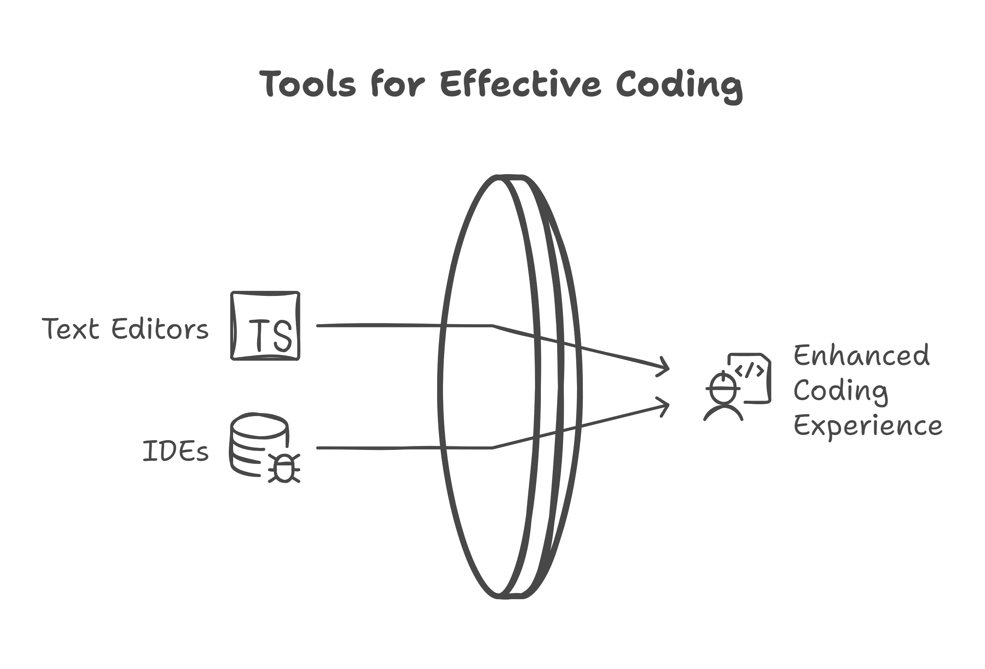
Text Editors and IDEs
Text Editors:
Lightweight tools for coding.
Examples: Notepad++, Sublime Text.
IDEs:
Integrated tools with debugging, version control, and auto-completion.
Examples: VS Code, IntelliJ IDEA.

Slide 14
Browser Basics
Key Functions of a Browser:
Rendering HTML and CSS: Displays web pages based on their code.
JavaScript Execution: Runs scripts to make web pages interactive.
Networking: Manages HTTP/HTTPS requests to fetch resources.
Browser Storage: LocalStorage, SessionStorage, Cookies for data storage.
What is a Browser?
A software application for accessing the World Wide Web.
Examples: Chrome, Firefox, Edge, Safari.
Developer Tools:
Tools within browsers to inspect and debug web pages
Tabs in DevTools:
Elements: Inspect and modify HTML/CSS.
Console: Debug JavaScript.
Network: Monitor API calls and page load times.
Practical Task:
Open DevTools in a browser and explore the Elements, Console, and Network tabs.

Slide 15
Frameworks and Libraries
What are Frameworks?
Predefined structures for building web applications.
Enforce rules, making development faster and more organized.
Examples of Frameworks:
Front-End: Angular, Vue.js.
Back-End: Express.js, Django, Ruby on Rails.
What are Libraries?
Collections of reusable code for specific tasks.
Provide flexibility but do not dictate structure.
Examples of Libraries:
React: For Single Page Application.
jQuery: Simplifies DOM manipulation.
Lodash: Provides utility functions for JavaScript.

Slide 16
APIs & Why They Matter
API = Application Programming Interface.
It allows two applications to communicate.
Example: Weather apps fetching live data from an external API.
Real-World Example: Login with Google/Facebook (OAuth API).

Slide 17
Activities for Students
Activity 1: Website vs Web Application Comparison
Objective:
Understand the difference between a website and a web application through real-world examples.
Instructions:
Research:
Open your browser and visit the following examples:
Website: www.wikipedia.org
Web Application: www.gmail.com

Slide 18
Identify Features:
Observe and note the following for each:
Purpose: What is the website or app designed to do?
Interactivity: Can you interact with the site (e.g., logging in, performing actions)?
Dynamic Content: Does the content change based on user actions?
Compare:
Write a short paragraph explaining the differences between the two.

Slide 19
Activity 2: Domain and Hosting Exploration
Objective:
Learn how domains and hosting work by exploring real-world examples.
Instructions:
Research a Domain Name:
Use a domain registrar like GoDaddy or Namecheap to search for a domain name (e.g., yourname.com).
Check its availability and note the cost.
Explore Hosting Plans:
Visit a hosting provider like Hostinger or Bluehost.
Identify the features offered in their hosting plans (e.g., storage, bandwidth, email accounts).
Write a Summary:
Explain the role of a domain name and hosting in making a website accessible.
Provide one example of a domain name and one hosting plan you explored.

Slide 20
Home Tasks (Assignments)
Research Task:
Find and list 5 static websites and 5 dynamic websites with reasons.
Practical Task:
Set up a GitHub repository and push a simple "Hello World" HTML file.
Exploration Task:
Use DevTools in the browser and inspect network requests of any website.
Write a short note on what type of files are loaded (HTML, CSS, JS, images, etc.).

Slide 21
Submission Notes
Capture Evidence:
Take screenshots or record a short video for each task.
Ensure your evidence clearly shows the completed task.
Upload Tasks:
Upload each task as a separate folder or file in your GitHub repository.
LinkedIn Post:
Create a short post summarizing what you learned and how you completed the tasks.
Highlight your key takeaways.
Mention the following account in your post:
Shahzad khan + Encoderbytes

Slide 22
Thank You

